Slide 1
Evaluating the Performance of Four Snooping Cache Coherency Protocols
Susan J. Eggers, Randy H. Katz

Slide 2
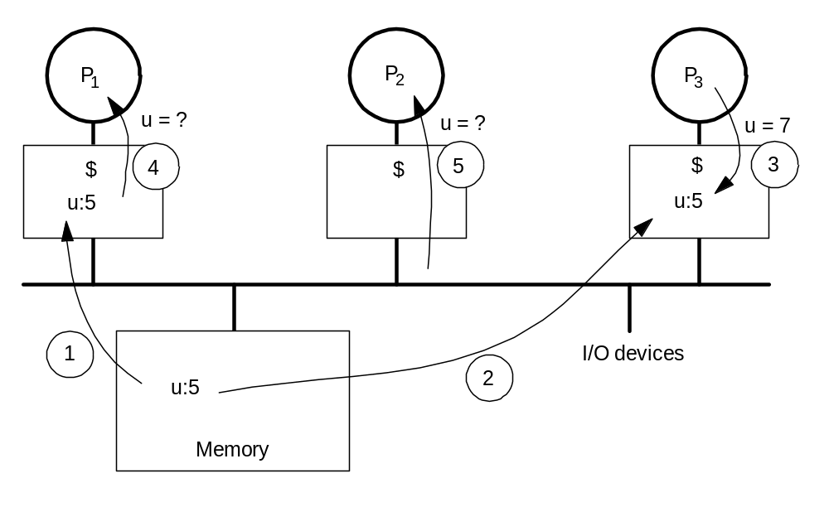
Example Cache Coherence Problem

Slide 3
Solutions - Protocols
Snooping protocols
  suitable for bus-based architectures
  requires broadcast
Directory-based protocols
  - sharing information stored separately (in directories)
  non-bus based architectures

Slide 4
Snooping Protocols
Suitable for bus-based architectures
Types –
* write – invalidate
- processor invalidates all other cached copies of shared data
- it can then update its own with no further bus operations
* write – broadcast
- processor broadcasts updates to shared data to other caches
- therefore, all copies are the same

Slide 5
Case Studies
Architecture
- shared-memory architecture
- 5 – 12 processors connected on a single bus
- one-cycle per instruction execution
- direct-mapped cache, one-cycle reads, two-cycle write
Applications
- traces gathered from 4 parallel CAD programs, developed for single-bus, shared memory multiprocessors.
- granularity of parallelism is a process
- single-program-multiple-data

Slide 6
Write-Invalidate Protocols
Writing processor invalidates all other shared (cached) copies of data.
Any subsequent writes by the same processor do not require bus utilization
Caches of other processors “snoop” on the bus
Example – Berkeley Ownership
(Invalid, Valid, Shared Dirty, Dirty)
Sources of overhead
  Invalidation signal, Invalidation misses

Slide 7
Write-Invalidate Protocols (Contd.)…
Cache coherency overhead minimized
  Sequential sharing (multiple consecutive writes to a block by a single processor)
  Fine-grain sharing (little inter-processor contention for shared data)
Trouble Spot
  High contention for shared data results in “pingponging”.
  Large block size
Simulation Results
  Proportion of invalidation misses to total misses increases with larger block sizes

Slide 8
Read-Broadcast: Enhancement to Write-Invalidate
Designed to reduce invalidation misses
Update an invalidated block with data, whenever there is a read bus operation for the block’s address
Required:
  Buffer to hold the data
  Control to implement read-interference
Improvements:
  One invalidation miss per invalidation signal

Slide 9
Performance Analysis of Read-Broadcast
Benefits
  Reduces the number of invalidation misses
  Ratio of invalidation misses to total misses increases with block size, but the proportion is lower than with Berkeley Ownership.
Side-Effects
  Increase in processor lockout from the cache
    CPU and snoop contention over the shared cache resource
    Snoop-related cache activity more than with Berkeley Ownership
    For 3 of the traces, the increase in processor lockout wiped out the benefit to total execution cycles gained by the decrease in invalidation misses.
  Increase in the average number of cycles per bus transfer
    Additional cycle required for the snoops to acknowledge completion of operation
    Need to update the processor’s state on read-broadcasts and simple state invalidations

Slide 10
Write-Invalidate/Read-Broadcast Comparison
If the processor lockout and number of execution cycles is large in Read-Broadcast, it may lead to a net gain in total execution cycles
Read-Broadcast is beneficial in the “one producer, several consumers” situation
An optimized cache controller will also improve the performance of Read-Broadcast

Slide 11
Write-Broadcast Protocols
Writing processor broadcasts updates to shared addresses
Special bus line used to indicate that blocks are shared
Examples - Firefly protocol (Valid Exclusive, Shared, Dirty - updates memory simultaneously with each write to shared data)
Sources of overhead
  sequential sharing: each processor accesses the data many times before another processor begins
  bus broadcasts to shared data

Slide 12
Write-Broadcast Protocols (Contd.) ...
Cache Coherency Overhead Minimized
  avoids “pingponging” of shared data (occurring in write-invalidate)
Trouble Spot
  Large cache size:
    lifetime of cache blocks increases, write-broadcasts continue for data that is no longer actively shared
Simulation Results
  Traces confirm the analysis
  Proportion of Write-Broadcast cycles within total cycles increases with increasing cache size

Slide 13
Competitive Snooping: Enhancement to Write-Broadcast
Switches to write-invalidate when the breakeven point in bus-related coherency overhead is reached
Breakeven point:
  Sum of write broadcast cycles issued for the address equals the number of cycles needed for rereading the data had it been invalidated.
Improvements:
  limits coherency overhead to twice that of optimal
Two algorithms
  Standard-Snoopy-Caching
  Snoopy-Reading

Slide 14
Standard-Snoopy-Caching
A counter (initial value = cost in cycles of a data transfer), is assigned to each cache block in every cache.
On a write broadcast, a cache that contains the address of the broadcast is (arbitrarily) chosen, and its counter is decremented.
When a counter value reaches zero, the cache block is invalidated.
When all counters for an address (other than that of the writer), are zero, write-broadcasts for it cease.
Reaccess by a processor to an address resets its cache counter to the initial value.
The algorithm’s lower bound proof demonstrates that the total costs of invalidating are in balance with the total costs of rereading.

Slide 15
Snoopy-Reading
The adversary is allowed to read-broadcast on rereads.
All other caches with invalidated copies take the data, and reset their counters.
When a cache’s counter reaches zero, it invalidates the block containing the address; and write broadcasts are discontinued, when all caches but that of the writer have been invalidated.
Other changes –
  On a write-broadcast, all caches containing the address decrement their counters
  Decrementing is done on consecutive write broadcasts by a particular processor

Slide 16
Snoopy-Reading Vs Standard-Snoopy-Caching
Advantages of Snoopy-Reading
  Well suited for a workload with few rereads
  Does not require hardware to “arbitrarily” choose a cache
  Snoopy-Reading invalidates more quickly than Standard-Snoopy-Caching

Slide 17
Performance Analysis of Competitive Snooping
Simulation results
  Decreases number of write broadcasts
  Benefit is greater when there is sequential sharing

Slide 18
Write-Broadcast/Competitive Snooping Comparison
Competitive snooping is beneficial in case of sequential sharing.
  Decreases bus utilization and total execution time
As inter-processor contention increases, competitive snooping results in an increase in bus utilization and total execution time

Slide 19
Conclusion
Write-Invalidate/Read-Broadcast
Read-broadcast is not suitable for sequential sharing
It may prove beneficial in the single-producer, multiple-consumer situation
Write-Broadcast/Competitive Snooping
Competitive Snooping is advantageous if there is sequential sharing

Slide 20
References
S.J. Eggers, R.H. Katz, “Evaluating the Performance of Four Snooping Cache Coherency Protocols”

Slide 21
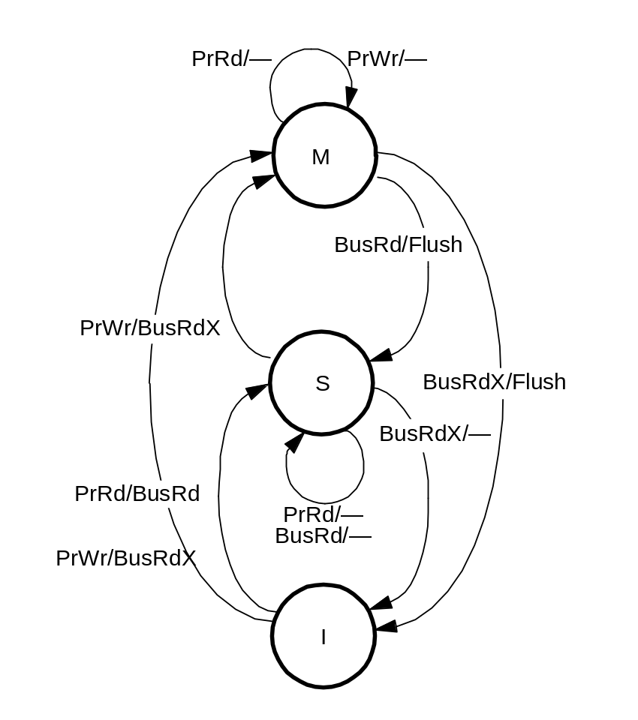
MSI State Transition Diagram
Modified
Shared
Invalid
Similar protocol used in
the Silicon Graphics 4D
Series multiprocessor
machines

Slide 22
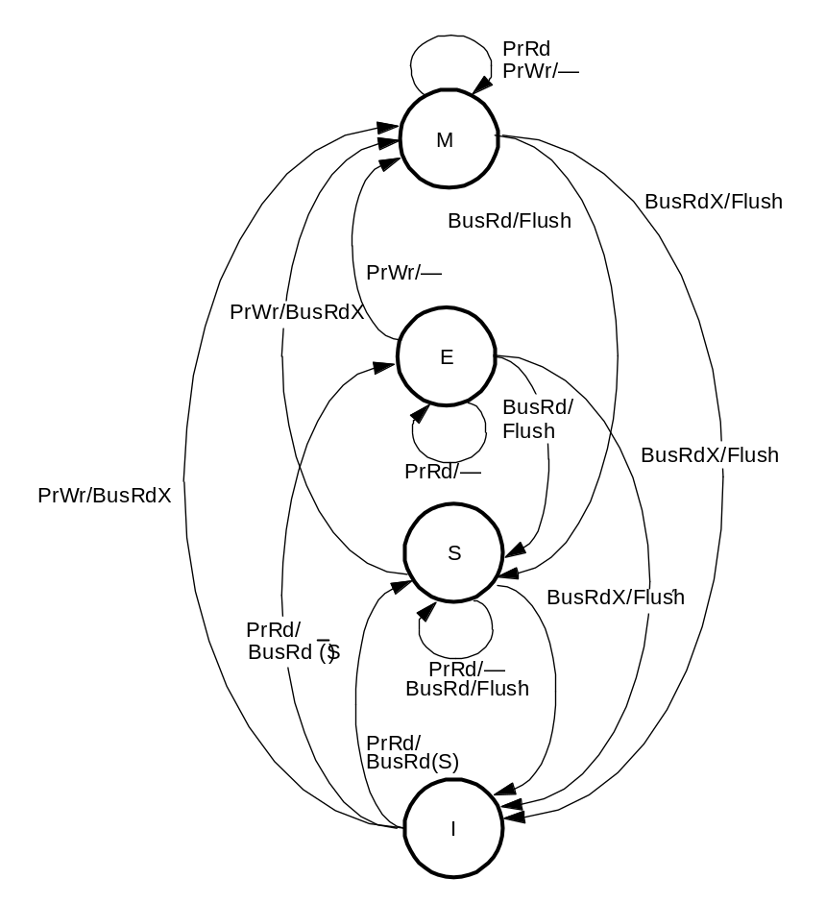
MESI State Transition Diagram
Modified
Exclusive
Shared
Invalid
Variants used in
Intel Pentium,
PowerPC 601,
MIPS R4400

Slide 23
MOESI Protocol
Owned state (Shared Modified): Exclusive, but memory not valid
Used in Athlon MP

Slide 24
Write-Once Protocol
I - Invalid V - Valid R - Reserved D - Dirty
PrRd/-
BusRd/-
BusWrOnce/-
BusRdX/-
V
I
PrRd/BusRd
PrRd/BusRd
BusRdX/-
PrWr/BusRdX
PrWr/BusWrOnce
BusRd/-
BusRdX/BusWB
PrRd/-PrWr/-
PrRd/BusWB
R
D
PrRd/-
PrWr/-
PrWr/BusRdX

